Slide 1

Priority Queues
COMP 272/400C:
Data Structures II
Prof. Silva
These slides were prepared by Prof. Silva adapting the slides from Data Structures & Algorithms in Java (Goodrich et al.) and Data Structures and Algorithm Analysis in Java (Weiss)

Slide 2
Priority Queue ADT
A priority queue stores a collection of elements
Main methods of the Priority Queue ADT
insert(k) inserts element k
removeMin() removes and returns the smallest element
Additional methods
min() returns, but does not remove the smallest element
size(), isEmpty()
Applications:
Standby flyers
Auctions
Stock market

Slide 3

PQ Sorting
We use a priority queue
Insert the elements with a series of insert operations
Remove the elements in sorted order with a series of removeMin operations
The running time depends on the priority queue implementation:
Unsorted sequence gives selection-sort: O(n²) time
Sorted sequence gives insertion-sort: O(n²) time
Can we do better?
Algorithm PQ-Sort(S, C)
Input sequence S, comparator C for the elements of S
Output sequence S sorted in increasing order according to C
P ← priority queue with comparator C
while ¬S.isEmpty ()
e ← S.remove (S. first ())
P.insert(e)
while ¬P.isEmpty()
e ← P.removeMin()
S.addLast(e)

Slide 4
Heaps
A heap is a binary tree storing keys at its nodes and satisfying the following properties:
Heap-Order: for every internal node v other than the root, key(v) ≥ key(parent(v))
Complete Binary Tree: let h be the height of the heap
for i = 0, … , h − 1, there are 2^{i} nodes of depth i
at depth h, all nodes are as far left as possible
The last node of a heap is the rightmost node of maximum depth
2
5
6
9
7
last node

Slide 5
Heaps and Priority Queues
We can use a heap to implement a priority queue
A heap storing n keys has height O(log n)
2
5
6
9
7

Slide 6
Insertion into a Heap
Method insertItem of the priority queue ADT corresponds to the insertion of a key k to the heap
The insertion algorithm consists of three steps
Find the insertion node t (the new last node)
Store k at t
Restore the heap-order property (discussed next)
2
5
t
6
9
7
insertion node
2
5
6
t
9
7
1

Slide 7
Upheap
After the insertion of a new key k, the heap-order property may be violated
Algorithm upheap restores the heap-order property by swapping k along an upward path from the insertion node
Upheap terminates when the key k reaches the root or a node whose parent has a key smaller than or equal to k
Since a heap has height O(log n), upheap runs in O(log n) time
2
1
5
1
5
2
t
t
9
7
6
9
7
6

Slide 8
Removal from a Heap
Method removeMin of the priority queue ADT corresponds to the removal of the root key from the heap
The removal algorithm consists of three steps
Replace the root key with the key of the last node w
Remove w
Restore the heap-order property (discussed next)
2
5
6
w
9
7
last node
7
5
w
6
9
new last node

Slide 9
Downheap
After replacing the root key with the key k of the last node, the heap-order property may be violated
Algorithm downheap restores the heap-order property by swapping key k (with its smaller child) along a downward path from the root
Downheap terminates when key k reaches a leaf or a node whose children have keys greater than or equal to k
Since a heap has height O(log n), downheap runs in O(log n) time
7
5
5
w
6
7
w
6
9
9

Slide 10
Updating the Last Node
The insertion node can be found by traversing a path of O(log n) nodes
Go up until a left child or the root is reached
If a left child is reached, go to the right child
Go down left until a leaf is reached
Similar algorithm for updating the last node after a removal

Slide 11
Heap-Sort
Consider a priority queue with n items implemented by means of a heap
the space used is O(n)
methods insert and removeMin take O(log n) time
methods size, isEmpty, and min take time O(1) time
Using a heap-based priority queue, we can sort a sequence of n elements in O(n log n) time
The resulting algorithm is called heap-sort
Heap-sort is much faster than quadratic sorting algorithms, such as insertion-sort and selection-sort

Slide 12
Merging Two Heaps
We are given two heaps and a key k
We create a new heap with the root node storing k and with the two heaps as subtrees
We perform downheap to restore the heap-order property
3
2
8
5
4
6
7
3
2
8
5
4
6
2
3
4
8
5
7
6

Slide 13
Bottom-up Heap Construction
We can construct a heap storing n given keys using a bottom-up construction with log n phases
In phase i, pairs of heaps with 2^{i} −1 keys are merged into heaps with 2^{i+1}−1 keys
2^{i} −1
2^{i} −1
2^{i+1}−1

Slide 14
Example
16
15
4
12
6
7
23
20
25
5
11
27
16
15
4
12
6
9
23
20

Slide 15
Example (contd.)
25
5
11
27
16
15
4
12
6
9
23
20
15
4
6
23
16
25
5
12
11
9
27
20

Slide 16
Example (contd.)
7
8
15
4
6
23
16
25
5
12
11
9
27
20
4
6
15
5
8
23
16
25
7
12
11
9
27
20

Slide 17
Example (end)
10
4
6
15
5
8
23
16
25
7
12
11
9
27
20
4
5
6
15
7
8
23
16
25
10
12
11
9
27
20

Slide 18
Analysis
We visualize the worst-case time of a downheap with a proxy path that goes first right and then repeatedly goes left until the bottom of the heap (this path may differ from the actual downheap path)
Since each node is traversed by at most two proxy paths, the total number of nodes of the proxy paths is O(n)
Thus, bottom-up heap construction runs in O(n) time
Bottom-up heap construction is faster than n successive insertions and speeds up the first phase of heap-sort

Slide 19
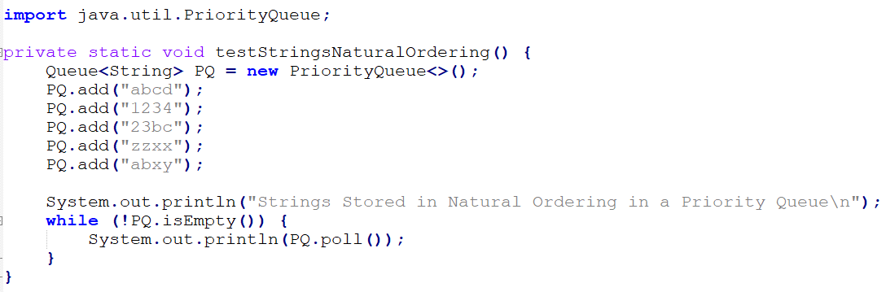
Priority Queue in Java
Main methods:
add (E e)
poll ()
isEmpty()
size()

